Slide 1

RBL SISIN CErdas
Fadhil Rausyanfikr - 10217006
Ahmad Fathoni - 10217037

Slide 2
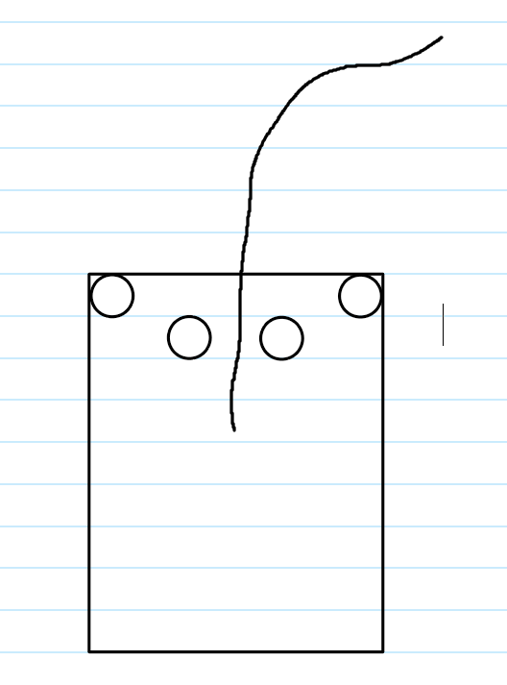
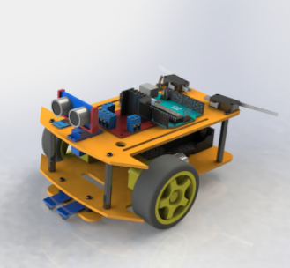
Model robot

Slide 3
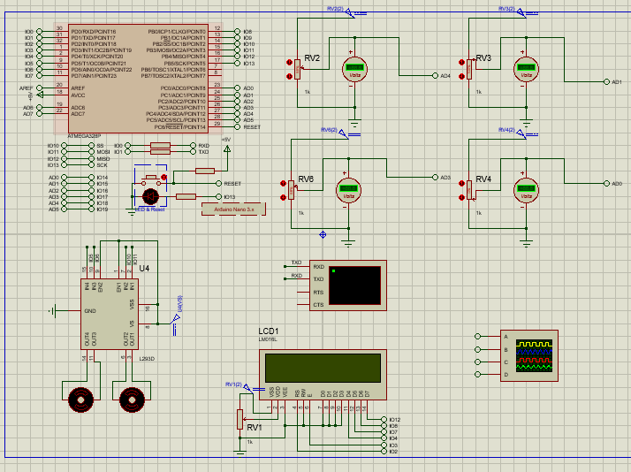
Skematik

Slide 4
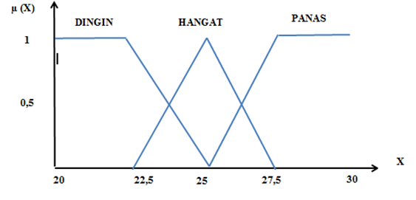
Tak Dideteksi
Buram
Dideteksi
0
2.5
3
3.5
5

Slide 5
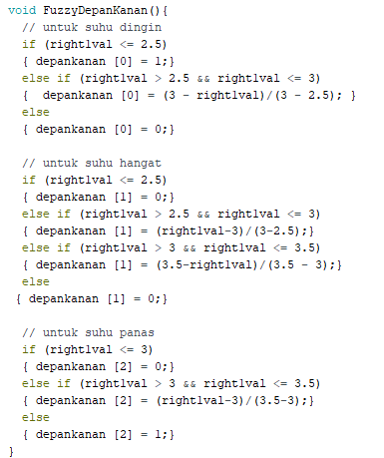
Code membership

Slide 6
Rules
Belakang /depan | tdk terdeteksi | buram | terdeteksi
tdk terdeteksi | cepat | lambat | lambat
buram | cepat | sedang | lambat
terdeteksi | cepat | cepat | lambat

Slide 7
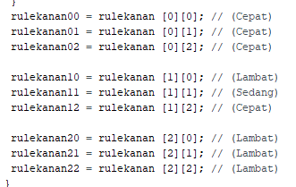
Rules Code

Slide 8
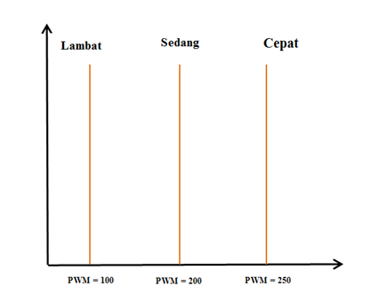
PWM keluar
PWM = 50
PWM = 150
PWM = 250

Slide 9
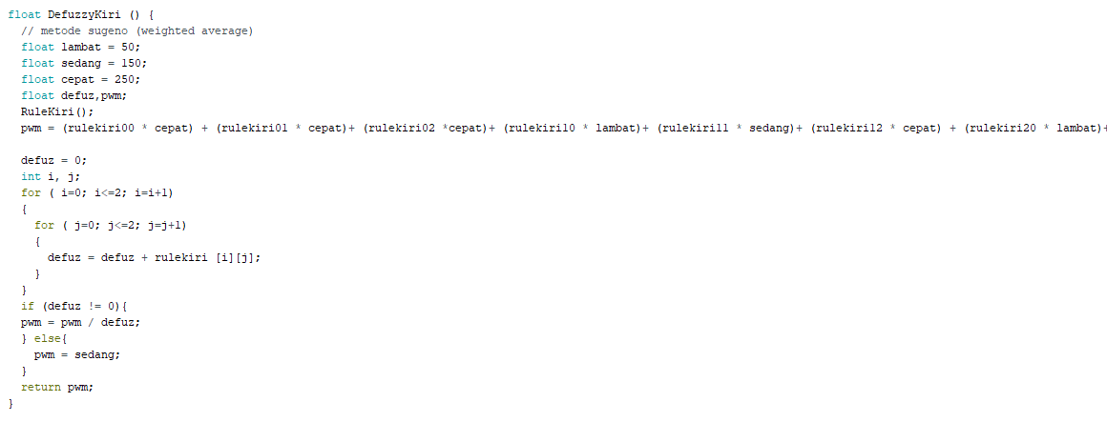
Code defuzzy

